Slide 1
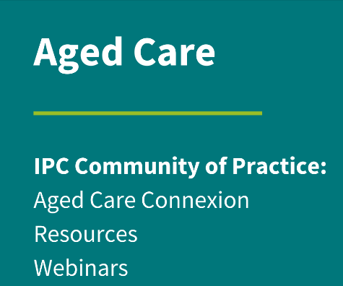
Looking at your facility through and IPC lens – what’s in an aged care IPC program?

Slide 2
ACIPC acknowledges Aboriginal and Torres Strait Island people as the traditional owners of country throughout Australia and ngā iwi Māori as the people of the land of Aotearoa and respects their continuing connection to culture, land, waterways, community, and family.

Slide 3
Disclaimer
There are no conflicts of interest

Slide 4
Objectives
At the end of this presentation, you should be able to:
Use the ACIPC Foundations course learnings and strengthened standards to help guide the IPC plan
State the areas where IPC interacts with other departments
Describe how to use and apply a risk assessment tool
Create a program plan for your residence using the risk assessment

Slide 5
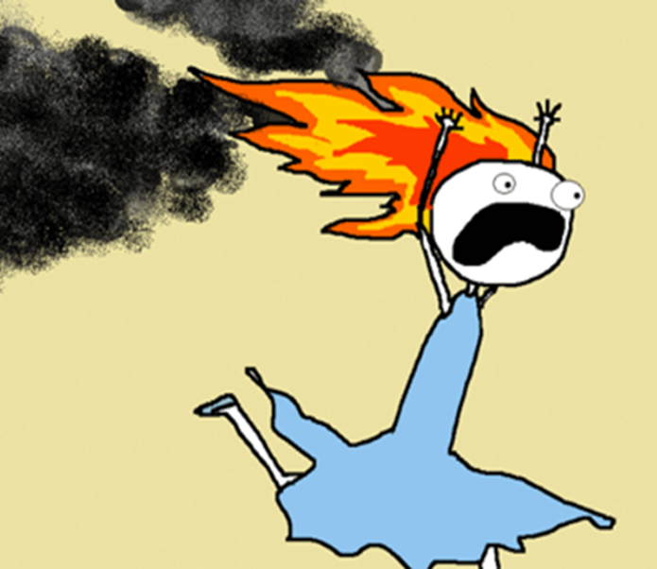
Introduction
The IPC role was implemented to aid with improving Infection Prevention and Control responses within Aged Care
Heavy focus has been with “control” – implementing practices after the event
Prevention strategies will aid with reducing the need to put out fires through control

Slide 6
In the Beginning…
Minimal Infection Preventionists in Aged Care
Focus was not on prevention activities – reactionary behavior’s
Hand Hygiene poor at best, most of the time completely lacking!
*Gloves used as a replacement for hand hygiene
MANTRA - “It’s not a hospital, it’s a home”

Slide 7
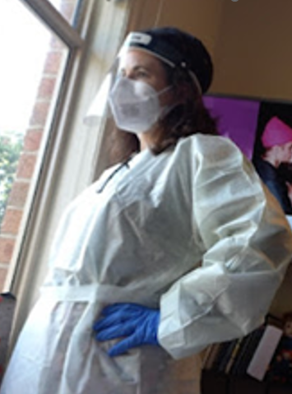
Pandemic time
Heavy focus on outbreak management
Administrative requirements increased exponentially
Constantly changing expectations
Little/no time for anything else!

Slide 8
Where We Are Now: Reactivity Remains the Driver
Outbreak management still challenging
IPC Lead role with little support or understanding
Staff ownership – it takes a village
Hospital versus home Mantra continues –
BUT it’s not OUR home!

Slide 9
What you have learned - ACIPC Modules
Foundations of Infection Prevention and Control modules
Introductory concepts in infection prevention and control: microbiology, immunology and epidemiology
Exploring the concepts and science of HAI prevention: hand hygiene, standard and transmission-based precautions
Surveillance and audit: concepts and application
Cleaning, decontamination and sterilisation: environmental hygiene & management of reusable devices
Outbreak management: communicable disease notifications
Multi-resistant organisms: antimicrobial stewardship
Aseptic technique and invasive devices: management and evaluation
International and Australian oversight of infection prevention and control strategies: clinical governance – responding to standards and guidance
Theories of leadership and motivation: professional issues
Employee health: vaccination, sharps safety, pregnancy. Blood and body fluid exposure response and management
Practice specific settings: aged Care, haemodialysis, invasive procedure settings, the built environment

Slide 10
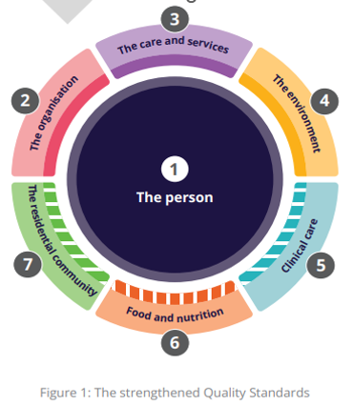
Aged Care Quality Standards
Strengthened standards expected this year
At the center is the resident – everything else we do revolves around them
IPC touches into every aspect of the new standards, The Commission just haven’t realized yet!

Slide 11
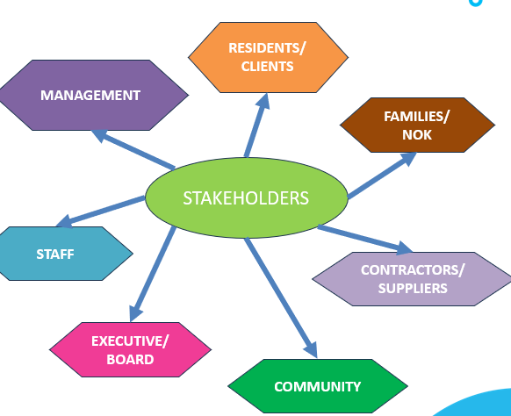
Key Stakeholder Engagement
Key stakeholders are those who either have the authority to implement change or those who the changes will impact
Early involvement of the key stakeholder(s) will impact the success of the elements you think should change
Key stakeholder input aids with identifying solutions to perceived risks and helps to solidify the sustainability once you remove yourself as the facilitator

Slide 12
Collaboration is key!
Take each individual role within the residence and break down the functions within that role
*Collaborate with the person/people in the role to aid with the review
Use historical data or information to identify possible risks
Ask questions – can you see any risks with what is currently in place?
*Use the risk assessment tool to assess the risk
Identify what IPC strategies are and/or should be in place
*Use learnings from the ACIPC modules, self-research, studies, information from other IPCs, reference state and national guidelines/recommendations

Slide 13
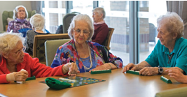
Top to Bottom and Outside to Inside
External environment proximity to the home – potential for severe weather to impact the home such as flooding
Front entry – what role does your administrative personnel play
Leisure and Lifestyle – communal activities and shared games, events, pets and pet therapy, visiting entertainment (includes barnyard, reptile, etc),
Food services – food safety program plan and adherence, café within the residence
Support services – hairdressers, allied health

Slide 14
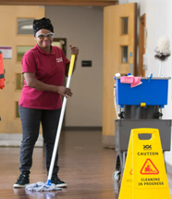
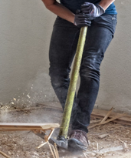
Who is not so obvious?
Property – water management plan, construction, renovation, maintenance, storage space
Cleaning and laundry – waste management, following contact/wet time, washing temperatures conducive to eliminating parasites and microorganisms
Procurement – correct product for the correct reason

Slide 15
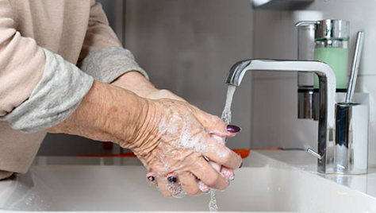
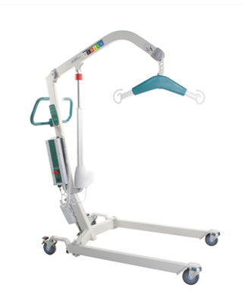
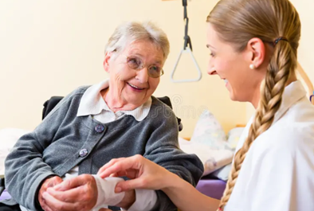
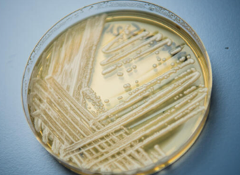
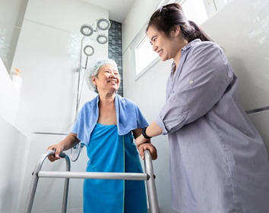
Center of it all

Slide 16
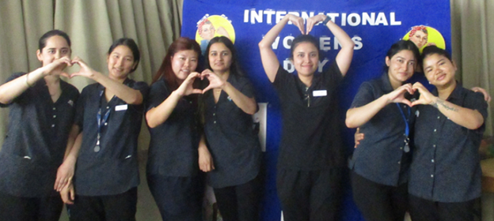
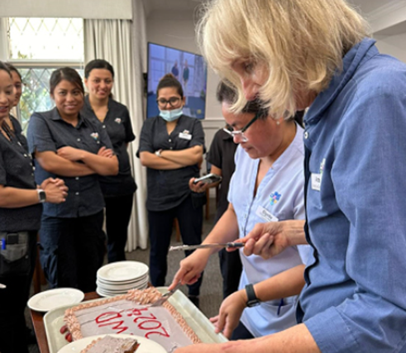
Staff Health

Slide 17
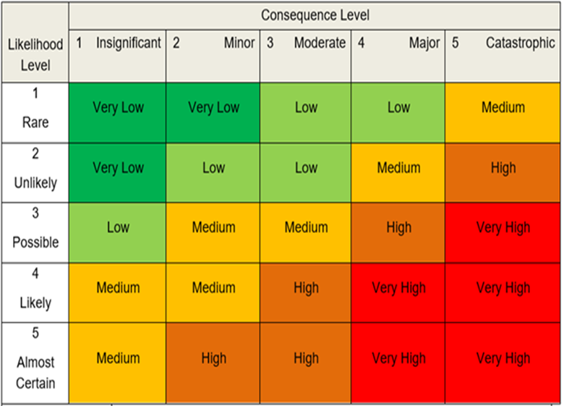
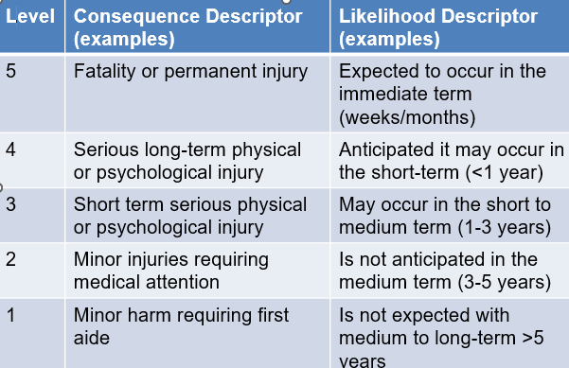
Using a risk assessment tool

Slide 18
Applying a risk to the risk matrix
Example water flushing plan to prevent legionella biofilm:
Is there a water flushing program in place?
Are all dead-legs included? How do you know?
Does flushing happen every 7 days or less? How do you know?
Are the following included in the program: empty resident rooms, occupied resident rooms where ensuite is not used, pan room, medication room? How do you know?
How often do you test for legionella and how are the areas for testing identified?
Have you had any positive results for legionella or “other species”? If yes, how often does that happen?
Using the table above, the consequence could be level 5 for a resident who acquires legionnaires disease that is not correctly identified.
The likelihood is dependent on testing results and how well the water management plan is implemented at your residence based on your state guidelines.
Experience - the maintenance/property officer interpreted “every 7 days” as “weekly”
The flushing timeline varied widely from one week to the next.

Slide 19
Example of a risk matrix with rationale

Slide 20
Building an IPC Plan from the Risk Matrix

Slide 21
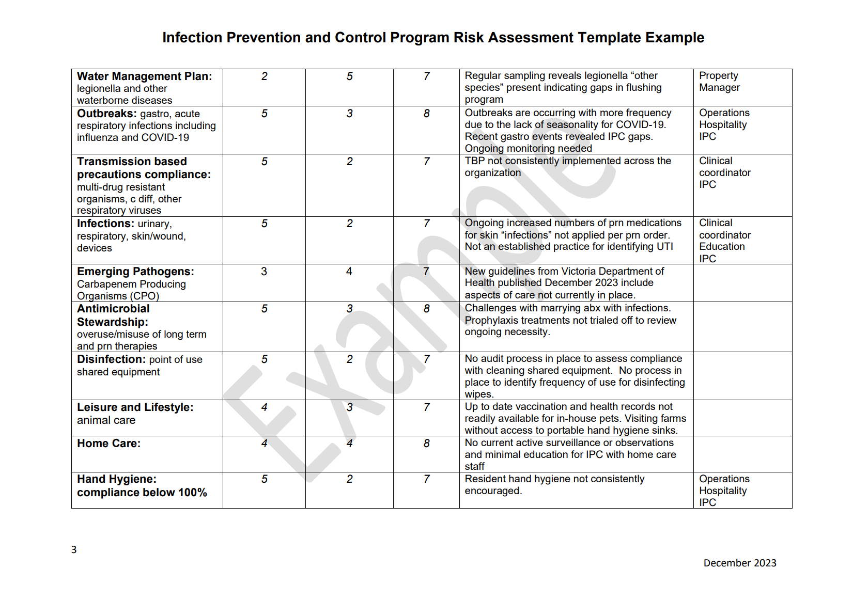
Review of Templates Placeholder
Sample Risk Assessment

Slide 22
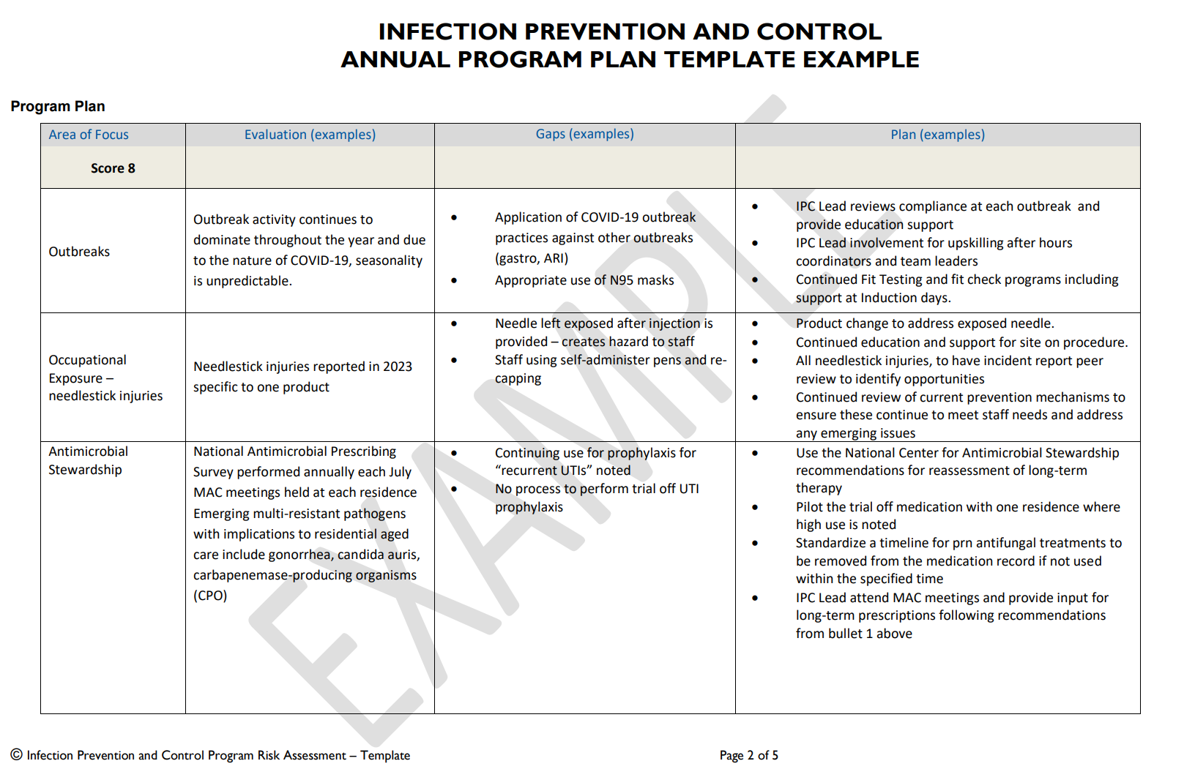
Review of Templates Placeholder
IPC Program Plan

Slide 23
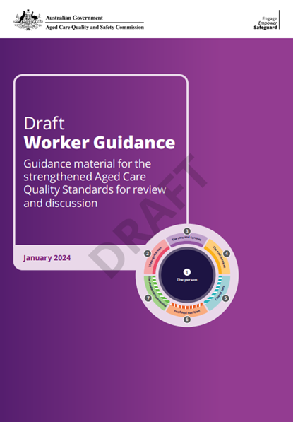
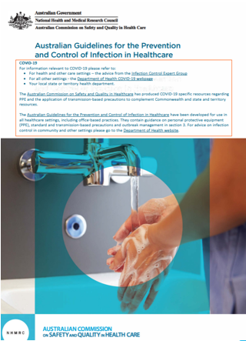
Putting it all together!
Use the ACIPC modules to outline plan
Peel off different categories – one at a time Review the Aged Care Quality Standards – worker guidance document and compare against your program plan https://www.agedcarequality.gov.au/sites/default/files/media/aged-care-quality-standards-draft-worker-guidance.pdf
Review the state and national guidelines to aid with your strategies
One step at a time

Slide 24
Sarah Gaines-Hill, RN, MSN, CIC General Manger Infection Prevention and Control
Australasian College for Infection Prevention and Control
Level 6
152 Macquarie Steet
Hobart TAS 7000
03 6281 9239
office@acipc.org.au
www.acipc.org.au

