Slide 1
Multi Resistant Organisms (MROs) in Residential Aged Care
With Penny Radalj

Slide 2
ACIPC acknowledges Aboriginal and Torres Strait Island people as the traditional owners of country throughout Australia and ngā iwi Māori as the people of the land of Aotearoa and respects their continuing connection to culture, land, waterways, community, and family.

Slide 3
Please download and install the Slido app on all computers you use
Join at slido.com #2315520
ⓘ Start presenting to display the joining instructions on this slide.

Slide 4
Questions and Answers
Please use either:
Slido Q&A
Zoom chat function for Q&A

Slide 5
Penny Radalj
Penny Radalj is a registered nurse with qualifications in critical care nursing and infection prevention and control.
Clinical experience includes 15 years of acute cardiac nursing, 12 years in a large regional health service as an Infection Prevention and Control consultant and now with the Barwon Southwest Public Health Unit (BSW PHU).
The past three years leading the BSW PHU supporting the 74 public and private residential aged care facilities in the Barwon South West region to provide advice and review IPC and acute respiratory outbreaks through onsite visits and offsite communication.

Slide 6
Aged Care IPC Resources
One stop shop aged care IPC resources – anything you need in aged care IPC is located on this page
https://www.acipc.org.au/aged-care/resources-australasian-aged-care/
Webinar resources, templates, guides are all also located her
Aged Care - this is your space!

Slide 7
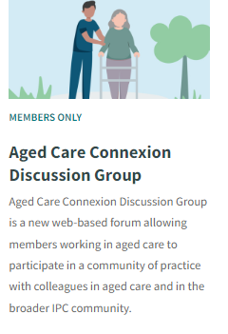
Aged Care Connexion
For further discussions or questions, please jump onto the ACIPC website Aged Care Connexion and add a post.
Any unanswered questions from the webinar will be posted in this space.
The forum is moderated and a safe place for aged care communications.
https://www.acipc.org.au/members/aged-care-connexion/
You do not have to be an ACIPC member to post
Aged Care - this is your space!

Slide 8
ACIPC Aged Care Community of Practice -Webinar Series
Webinars of 2025
Occur monthly and mid month
Dates and varied topics will be on the website from Jan 2025
Capacity to register will be available
All recordings, PowerPoints and resources will be placed on the CoP webinar page
ACIPC Aged Care Community of Practice Webinar Series
https://www.acipc.org.au/acipc-aged-care-community-of-practice-webinar-series/

Slide 9
Merry Christmas and Happy New Year
Look forward to seeing you all in 2025

Slide 10
Carrie Spinks Aged Care IPC Consultant carrie.spinks@acipc.org.au
Australasian College for Infection Prevention and Control
Level 6
152 Macquarie Steet
Hobart TAS 7000
03 6281 9239
office@acipc.org.au
www.acipc.org.au

