Slide 1
The Importance of Hand Hygiene
Kate Manserra – Clinical Nurse Educator
Infection Prevention & Control - Mersey Community Hospital

Slide 2
Overview & Objectives
Explore and evaluate two recent regional hand hygiene campaigns
Encourage the culture of speaking up for safety
Start planning what your organisation will do for World Hand Hygiene Day this year
Consider about hat audiences and issues you specifically want to target in your hand hygiene education, and how?

Slide 3
Background
Notes:
Throughout December 2020 a snapshot audit of hospital visitor hand hygiene compliance on entering and leaving the hospital was conducted. The total number of visitors audited was 180. Overall, there was 62% compliance in using hand sanitiser when entering or leaving the hospital at the main entrance. Compliance on arriving was 85% while compliance on leaving was 15%.
Past audits of visitor hand hygiene at Mersey Community Hospital (MCH) have revealed much lower rates of compliance.
The likely explanation for such a dramatic increase in compliance is the increase in public awareness of hand hygiene due to the COVID-19 pandemic, increased signage and hand sanitiser access, the visitor screening process, increased motivation, and increased habit with sanitising hands now a regular occurrence in a wide variety of settings outside the home such as supermarkets, restaurants and so on.

Slide 4
Why is visitor hand hygiene so low?
Notes:
These past results were consistent with international studies of hospital visitor hand hygiene compliance where baseline rates were between 8% and 10% (El Marijiya et al, 2019; Birnbach et al, 2015; Birnbach et al, 2012).
Research shows that visitors rarely clean their hands in healthcare settings (El Marijiya et al, 2019; Birnbach et al, 2015; Birnbach et al, 2012).
One factor that may limit hand hygiene by healthcare facility visitors is uncertainty regarding when hand hygiene should be performed.
A 2019 study showed compliance increased from <10% to 87% with educational intervention on entering a healthcare facility, with visitors expressing a preference for verbal reminders and signage (El Marijiya et al, 2019).
A 2020 study (Knighton et al, 2020) illustrated the effectiveness of an educational poster for healthcare facility visitor hand hygiene with 4 distinct moments: (1) Entering the facility, (2) After touching shared items, (3) Entering and exiting a patient's room, and (4) Exiting the healthcare facility.

Slide 5
Campaign - World Hand Hygiene Day May 5th, 2021
Notes:
A working party was initiated to prepare for a World Hand Hygiene Day promotion across all Tasmanian Health Service (THS) sites.
A new slogan “Enter Our Door – Do The 4” was created.
A poster and banner were developed, with input from a graphic design department, and tested on consumers for understanding. There are three different versions for hospitals, primary health sites, and aged care facilities.
Media interviews were arranged with local radio stations and a daily newspaper.
An inpatient brochure especially for the day was distributed with breakfast trays.
Posters were distributed throughout the organisation’s healthcare facilities.
Infection control nurses manned foyer displays to engage with consumers, discuss the poster, practice hand hygiene technique, do glitter bug activities and to give away hand hygiene merchandise.
Morning radio interviews were held on ABC Northern Tasmania and SEA FM about importance of hand hygiene and new slogan.
Article in The Advocate newspaper with distribution of 23,000.
Facilities across the state got involved, displayed the posters and ran their own activities, from St Helens to Rosebery.

Slide 6
Radio interviews

Slide 8
Engaging with consumers
Notes:
Identification of specific moments when hand hygiene measures are indicated is used to improve understanding, training, and monitoring of healthcare worker and patient hand hygiene (Sunkesula et al, 2015).
One factor that may limit hand hygiene by healthcare facility visitors is uncertainty regarding when hand hygiene should be performed (Knighton et al, 2020).
Knighton et al’s research studied the effectiveness of an educational poster for healthcare facility visitor hand hygiene moments.
In 2021, as part of World Hand Hygiene Day celebrations (May 5th), Tasmanian Health Service – North West decided to raise community awareness of hand hygiene while visiting health care facilities though a variety of activities including face to face interaction and activities with visitors as they entered the hospital, launching a new poster and slogan, and media engagement.

Slide 9
But has it been effective??
Notes:
A follow up audit of visitor hand hygiene was conducted in October 2021. Visitor hand hygiene was 81% compliant on entering the hospital, 18% on exiting, and on average 39% across the four moments.
There were some challenges in auditing all four moments. Capturing hand hygiene moments on entering and exiting the facility were simple and many moments could be recorded in short time frames, but capturing moments after touching shared items, or after entering patient areas/clinic rooms was not time efficient or appropriate privacy-wise.
Screening staff prompt visitors verbally when they interact with them to do hand hygiene upon entering. This increased the percentage of people doing hand hygiene upon entering significantly. It was only during busy times when screening staff could not prompt every single visitor, that some slipped through without doing hand hygiene.
When visitors self-check in they were less likely to do hand hygiene.
Collegial and public feedback was very positive, particularly around the media appearances. The campaign was a closely guarded secret until the day, so staff were surprised when they saw and heard the media interviews. Some hospital visitors on the day said they had heard the radio interview that morning.
Posters and banners remain around the hospital as a visual reminder.
Our 2022 visitor hand hygiene audit had 37% overall compliance, 51% compliance on entering the hospital and 19% on exiting. Screening staff were no longer prompting visitors to do hand hygiene. This shows hand hygiene is still significantly higher than any years prior to 2020. A 2 hour audit at the entrance to our busiest ward yielded results of only 9% hand hygiene on entering/exiting by visitors.
In the context of the COVID-19 pandemic, there is a need for all healthcare facilities to develop policies and procedures to reduce the risk for acquisition and transmission of pathogenic microorganisms by visitors. Ongoing education and prompting on basic infection control measures such as social distancing, mask-wearing, and hand hygiene will be required.

Slide 10
ACIPC online conference 2021

Slide 12
2022 - Staff hand hygiene
Baseline auditing (Quantitative data)
During National Hand Hygiene Audit Periods 1, 2 & 3 in 2021 (a 12-month period From April 2021 to March 2022), at Mersey Community Hospital, 1492 HH moments were collected and the data showed:
81% overall compliance
4.2% of HH moments missed when gloves taken OFF
24.2% of HH moments missed when gloves put ON
23.4% of HH moments missed when gloves were used in any way (including continued use).
This was concerning that when gloves were used, the compliance rate was less than the safe minimum benchmark (80%) and less than the overall compliance rate, suggesting that gloves were being used by some as a substitute for performing hand hygiene, as the international literature suggests.
Notes:
Baseline auditing (Qualitative data)
During National Hand Hygiene Audit Periods 1, 2 & 3 in 2021 (a 12-month period From April 2021 to March 2022), at Mersey Community Hospital, 1492 HH moments were collected and the data showed:
81% overall compliance
4.2% of HH moments missed when gloves taken OFF
24.2% of HH moments missed when gloves put ON
23.4% of HH moments missed when gloves were used in any way (including continued use).
This was concerning that when gloves were used, the compliance rate was less than the safe minimum benchmark (80%) and less than the overall compliance rate, suggesting that gloves were being used by some as a substitute for performing hand hygiene, as the international literature suggests.

Slide 13
World Hand Hygiene Day 2022

Slide 14
Qualitative research questions included
What are some instances you have (or have observed colleagues) wearing gloves when they are probably not required?
What are the potential harms/problems that can result from wearing gloves in situations such as these?
In what situations do healthcare workers need to wear gloves?
Which hand hygiene moment do you think gets missed most often (by you and or others)?

Slide 15
Notes:
Literature review
Reduced hand hygiene compliance and increased risk of spreading pathogens with routine glove use [2][3]. Gloves can create a false sense of security that encourages inappropriate use and paradoxically, a decrease in hand hygiene compliance and in increase in the risks they are supposed to prevent [2]. Wide and easy access to alcohol-based hand rub and continual auditing and teaching about indications for glove use is essential to emphasising hand hygiene over “routine” glove use [2]. An understanding of the drivers of glove misuse is needed to design effective interventions to reduce misuse and overuse [3]. Gloves reduce hand contamination with multi-resistant organisms (MROs) by up to 70%, hence they are beneficial in contact precautions [2]. After the removal of gloves 5 – 29% of hands have residual contamination [2]. Contamination of healthcare workers’ skin and clothing occurs frequently during the removal of gloves (and gowns) [4]. Glove use must be explicitly integrated into hand hygiene policy [2]. There is a need for education to improve glove removal technique and reinforce importance of hand hygiene before and after glove removal [4]

Slide 16
Opportunistic individual feedback during auditing
Notes:
Opportunistic individual feedback during auditing
Several hand hygiene auditor training programs occurred during the campaign period and a point was made to demonstrate providing feedback on different types of inappropriate and unsafe glove use during the practical ward sessions and post training supervised sessions.
Individuals observed were approached and asked open-ended questions that allowed them to first reflect and see if they were already aware that it was not hygienic, such as:
“Excuse me, do you know what continued glove use is?’
“Is that the same pair of gloves you were wearing for the previous task?”
“Do you know that you need to change your gloves and do hand hygiene before you start a procedure in a contact precautions room?”
“Can I ask why you are wearing gloves for this task?”
This line of question allowed the individual staff think about rationale, and provide any individual reasons to the educator for the glove use (eg. lack of awareness of the infection risk, dermatitis issues, “I just like wearing gloves because I feel more protected”) that could be discussed.

Slide 17
Audit results since campaign
From April 2022 to February 2023, at Mersey Community Hospital, 1461 HH moments were collected and the data showed:
82% overall compliance
6.2% of HH moments missed when gloves taken OFF
14.3% of HH moments missed when gloves put ON
16.6% of HH moments missed when gloves were used in any way (including continued use).
There has been a significant improvement (8 - 10% improvement in HH during glove use, however overall compliance has only marginally improved by 1%).
Notes:
So, has any of this made any difference?

Slide 18
Glove use will continue to be monitored closely and feedback provided.
Notes:
Staff engaged enthusiastically with the interactive activities and information.
An organisation-wide extensive campaign incorporating a variety of learning styles, and commitment to providing feedback and one-to-one ad hoc education and discussion around glove misuse when it is observed during hand hygiene auditing, is an effective way to improve hand hygiene compliance when gloves are used, and break down habits and misunderstanding around “glove misuse”.
Glove use will continue to be monitored closely and feedback provided.

Slide 19
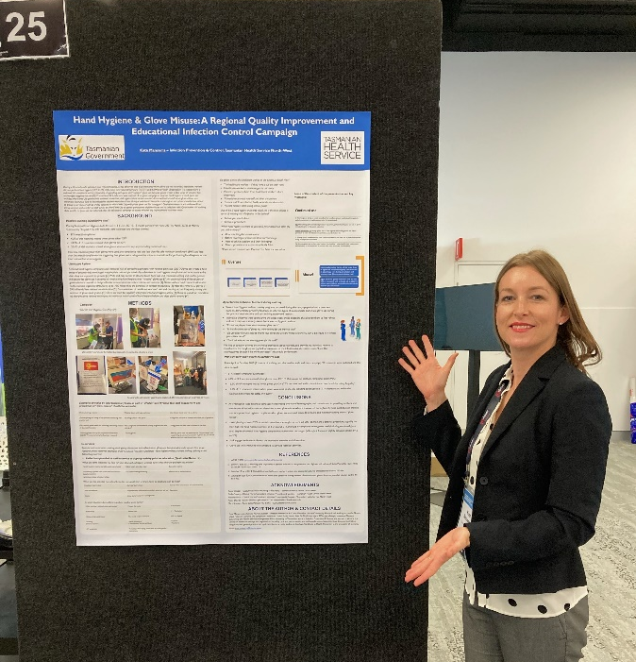
ACIPC Conference 2022, Sydney

Slide 20
Acknowledgements
Karen Linegar – Executive Director Nursing & Midwifery – THS-NW
Heather Firth – Clinical Nurse Consultant Infection Prevention & Control – THS-NW
Eliza Williams – Media and Communications Officer – THS
Fleur King – Media and Communications Manager Mersey Community Hospital – THS-NW
Cathy Smith – Project Nurse Strategic Support and Innovation – THS-NW
Emily Cutting – Clinical Nurse Consultant, Infection Prevention & Control – Tasmanian Health Service North-West
Kerry Blewitt – Senior Product Specialist VIC/TAS Microshield – Shuelke Australia
Mark Scanlan – Acute Sales Manager VIC & TAS – Gama Healthcare Australia

Slide 21
References
Birnbach, D., Nevo, I., Barnes, S., Fitzpatrick, M., Rosen, L. F., Everett-Thomas, R et al (2012). Do hospital visitors wash their hands? Assessing the use of alcohol-based hand sanitizer in a hospital lobby. Am J Infect Control, 40:340-3.
Birnbach, D.J., Rosen, L.F., Fitzpatrick, M., Arheart, K.L., Munoz-Price, L.S. (2015) An evaluation of hand hygiene in an intensive care unit: are visitors a potential vector for pathogens? J Infect Public Health. 8:570–574.
El Marijiya Villareal, S., Khan, S., Oduwole, M., Sutanto, E., Vleck, K., Katz, M. and Greenough, W.B. (2019) Can educational speech intervention improve visitors’ hand hygiene compliance? Journal of Hospital Infection, 104, 4. DOI: 10.1016/j.jhin.2019.12.002
Knighton, S.C., Zabarsky, T. F. & Donskey, C.J. (2020). Four moments for healthcare facility visitor hand hygiene. Am J Infect Control. 2020 Nov; 48(11). doi: 10.1016/j.ajic.2020.08.017
Moore, L. D., Robbins, G., Quinn, J & Arbogast, J. W. (2021) The impact of COVID-19 pandemic on hand hygiene performance in hospitals. American Journal of Infection Control, 49, 1. https://doi.org/10.1016/j.ajic.2020.08.021
Sunkesula, V. C. K., Knighton, S. & Zabarsky, T.F. (2015) Four moments for patient hand hygiene: a patient-centered, provider-facilitated model to improve patient hand hygiene. Infect Control Hosp Epidemiol, 36:986–989
WHO (2009) glove-use-information-leaflet.pdf (who.int)
Bellini C et al, 2022. Providing care to patients in contact isolation; is the systematic use of gloves still indicated? Swiss Med Wkly. 152:w30110 doi: 10.4414/SMW.2022.w30110
Loveday HP et al, 2014. Clinical glove use: healthcare workers’ actions and perceptions. Journal of Hospital Infection 86: 110-116
Alhmidi H et al, 2019. Contamination of health care personnel during removal of contaminated gloves. American Journal of Infection Control 47: 850-852.

